Slide 1
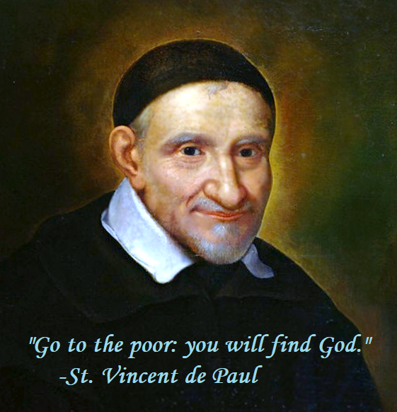

Society of Saint Vincent de Paul
Orientation Session

Slide 2

agenda
Welcome and Introductions
Spiritual Reflection
History of SSVP
Hamilton Structure
Roles within SSVP
Questions

Slide 3
Welcome:
JOHN

Slide 4

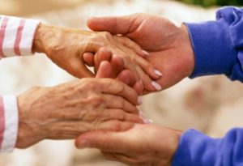
Vocation:
A CALL to serve OTHERS.

Slide 5

Introductions
Who we are.
Why we chose to become SSVP volunteers.
How being a SSVP member has impacted our lives.

Slide 6


Slide 7
Spiritual Reflection:
ANNE

Slide 8
SPIRITUAL REFLECTION: ORIENTATION SESSION, OCTOBER 29, 2024
BIBLE PASSAGE: (Psalm 34: 6, 18) “The Lord hears the cry of the Poor”
“The poor man cried out and the Lord heard him,
And saved him out of all his troubles.
The Lord is near to the broken hearted,
And saves the crushed in spirit.
QUESTIONS:
Do you see a description of the neighbours in need, that we visit, in this Psalm?
What encouragement do we get from this Psalm that will help us when we interact with our neighbours in need?

Slide 9
History of SSVp:
PAUL

Slide 10
A short History of the Society of st. Vincent de paul
Mission Statement:
To live the gospel message by serving Christ in the poor with LOVE, RESPECT, JUSTICE and JOY.

Slide 11
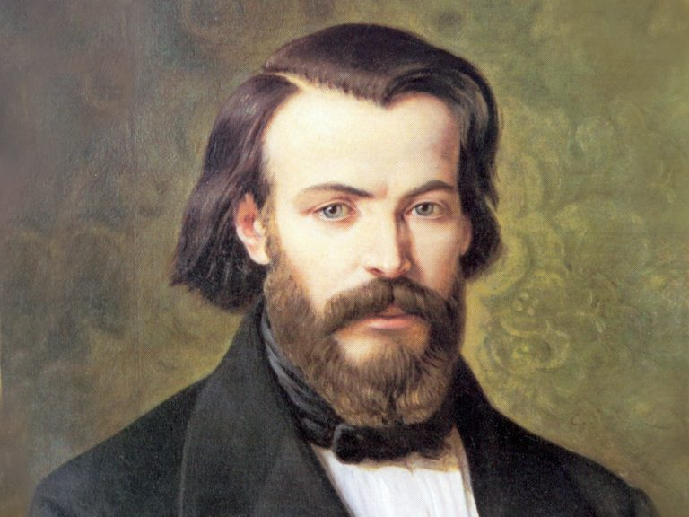
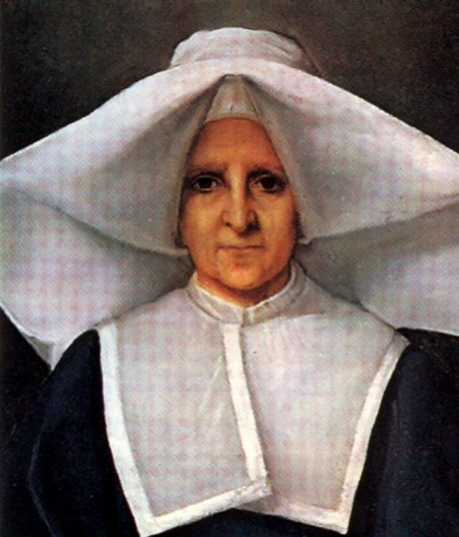
The Society began in France in 1833 founded by a 20-year-old legal student named Frederic Ozanam.
His small student group was coached for two years by Sister Rosalie Rendu.

Slide 12
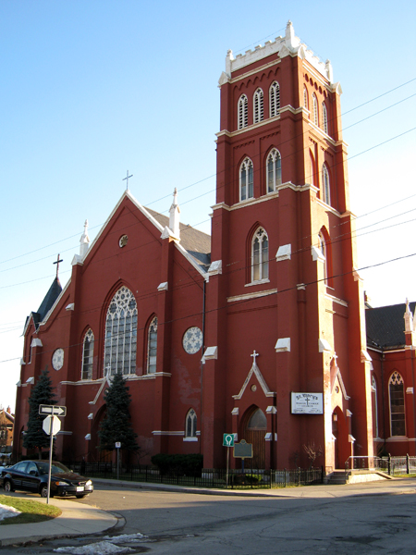
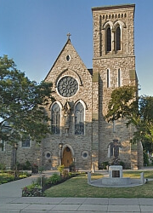
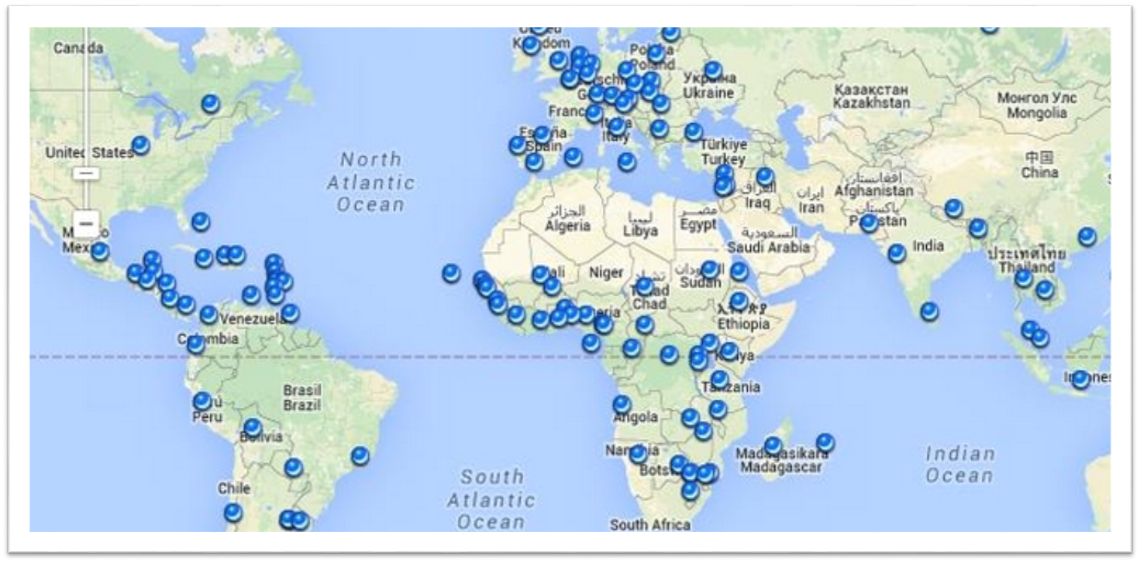
In Canada, the Saint Vincent de Paul society first began in Quebec 176 years ago.
20 years later the first Hamilton conference was started at St. Mary’s followed by St. Patrick’s Parish.
St. Mary’s
St. Patrick’s
It is now coast to coast from Newfoundland to British Columbia. Canada now has close to 800 conferences.
It is also established in 153 countries with 800,000 members.

Slide 13

What we advocate for:
-Change in government policies to achieve better conditions
-Enrollment in the Canada Learning Bond
-Use of free dental clinics for children
-Registering for free municipal passes
-Three-year housing initiative

Slide 14
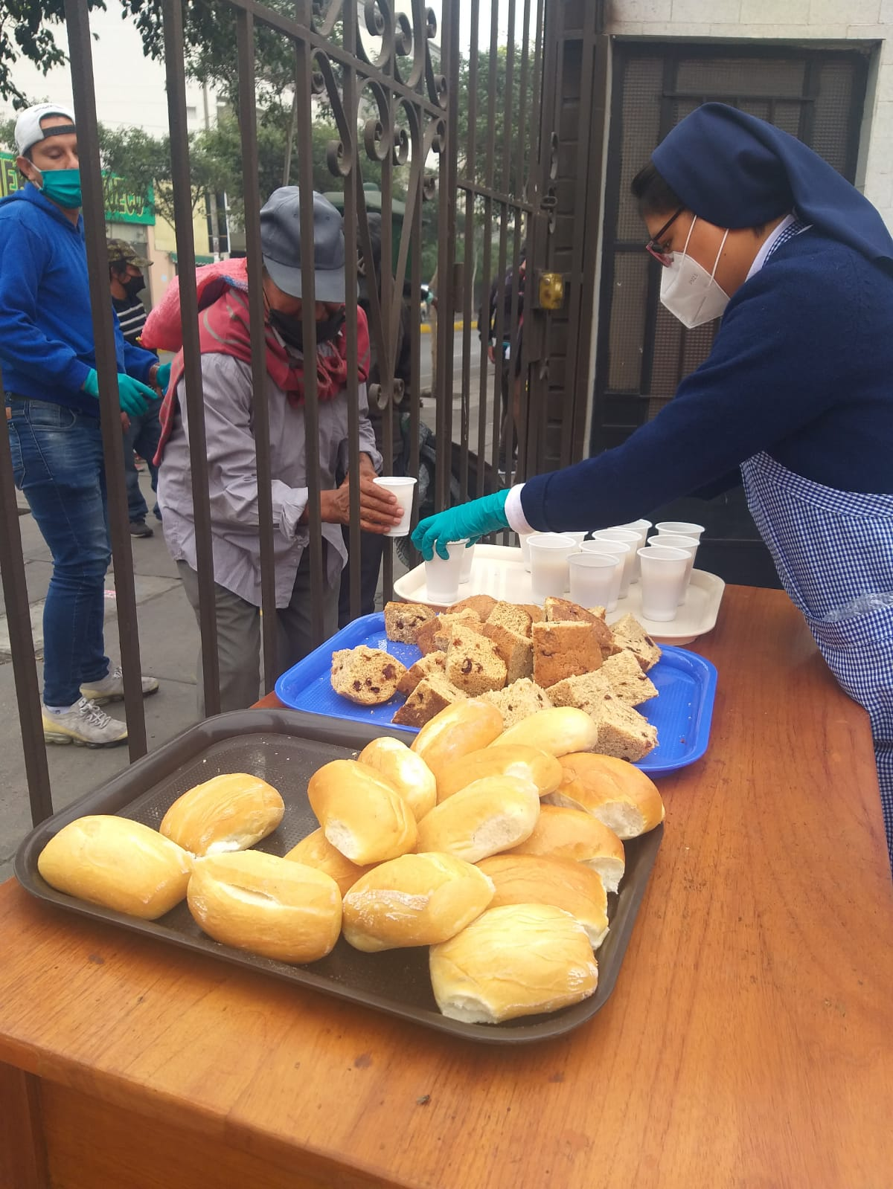
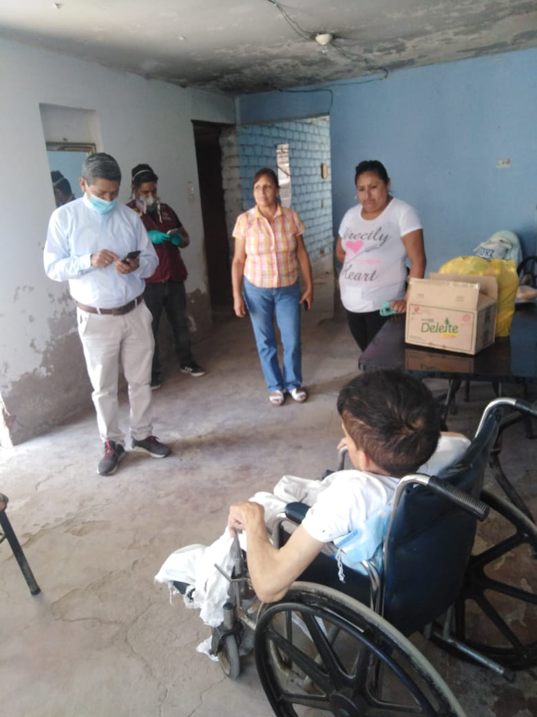
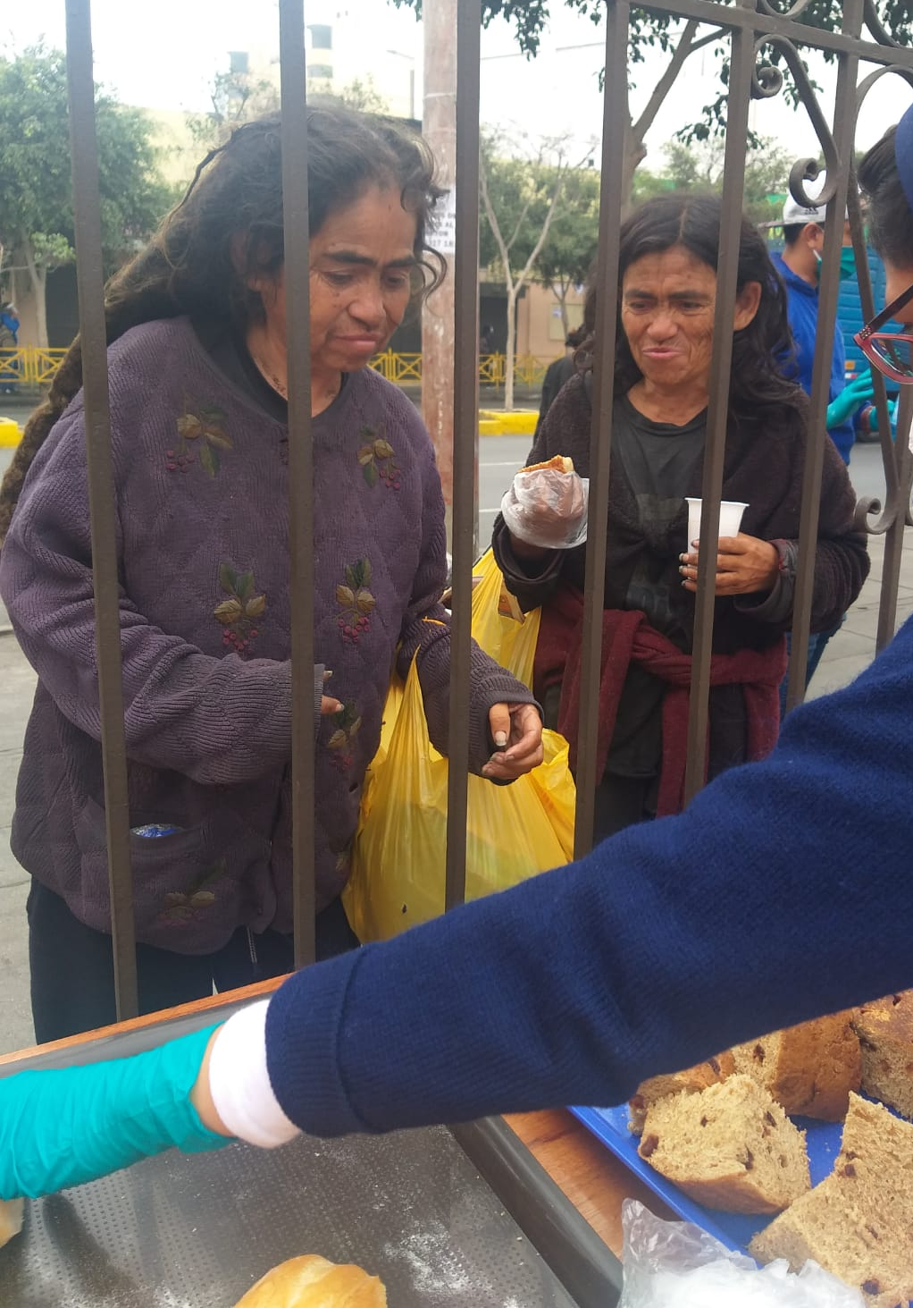
Twinning
We also have a North-South twinning programming where a Canadian Conference can communicate with a Conference in a less fortunate country on a continuing basis and offer financial support.

Slide 15
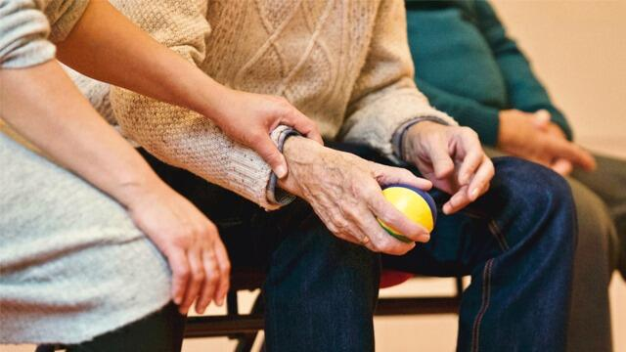

How are we different?
-One-to-one contact and home visits
-Foster spiritual growth

Slide 16
SSVP Hamilton:
John

Slide 17
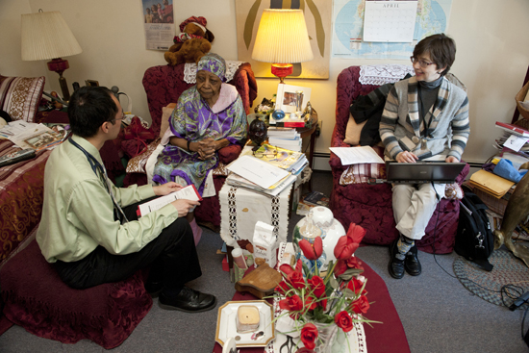
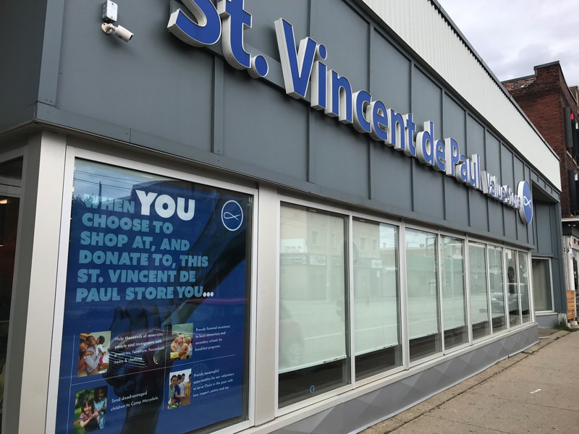
SSVP Highlights and web site
Home Visits
Logo
Stores
Notes:
Stores – always looking for volunteers.
Logo
The fish is the symbol of Christianity and, in this case, represents the Society of Saint Vincent de Paul.
The eye of the fish is the vigilant eye of God seeking to help the poor in our midst.
The crossing at the tail or the tie-knot represents unity and oneness among members and also the union with the poor.
The circle bounding the logo signifies the global or worldwide stature of the SSVP, an international Society
The phrase serviens in spe means to serve in hope, the hope that comes from Our Lord Jesus Christ

Slide 18
SSVP Highlights and web site
A walk through our web site…..
https://ssvphamiltonpc.org/

Slide 19
Roles within ssvp:
Dan

Slide 20

Executive roles within the conference
President
Vice President
Secretary
Treasurer
Spiritual Advisor
Coordinators as deemed needed by the Conference
Social Justice Representative
Youth Representative
Restorative Justice Representative

Slide 21

Any Questions?

Slide 22


